Slide 1



Optimal Targeting &
Lead Conversion Strategy
For World Plus
ANALYTICMINDS

Slide 2


INDEX
1) Market Overview
1. Market & Company Analysis
2) Competitors Analysis
3) Objectives
1) Key Features of Model
2. Model Suggestion
2) Model Performance
3) Forecasting
3. Marketing Strategies
1) Customer Profile
2) Marketing Strategies

Slide 3




1. Market & Company Analysis
Market Overview
The recent sharp increases in inflation and high interest rates have significantly impacted the banking industry.
World+
Customers
Competitors
Company
Inflation &
High Interest Rate
Experiencing pressure from rising living costs and interest rates
Rising competition
with technological advancements
Traditional mid-size bank
in the UK
Broad banking service coverage including online banking
Rising loan delinquency
Growth of fintech sector
& trial to adapt generative AI
Effective targeting & marketing are crucial
Hesitant about taking out new loans or refinancing
Providing bank account switching bonus

Slide 4
1. Market & Company Analysis
Competitor Analysis
Competitors aim to secure loyalty, and expand online presence to attract and retain customers
Retention
Acquisition
Focus on creating FANS
Physical
Presence &
Customised service
Build out a strong digital offering
Switching
Incentives &
Referral
Marketing
￡5,000,000*
Retention
Acquisition
Digital Bank with branches
Customer voice analysis for enhancing customer satisfaction
Digital
transformation
Actively use social media paid marketing
￡4,820,000*
*Marketing & Media Expenditure

Slide 5
1. Market & Company Analysis
Objectives
We strive to understand and fulfill our clients' requirements by delivering the most accurate models.
WHAT WORLD PLUS NEEDS​
WHAT WE CAN PROVIDE
Identify
potential customers
who will convert
Reach targeted customers
through communication channels​
Minimise unnecessary cost on uninterested customers​
Accurate machine learning
targeting models
Actionable insight
and recommendation
Up-to-date models
and maintenance
Continuous
monitoring system

Slide 6
2. Model Suggestion
Our Model (SVM) Performance​
We will accurately target valid customers while optimising cost efficiency.
Model Performance
Targeting
Accuracy
41%p
*
Cost
Efficiency
34%p
*
Target
Volume
28%p
*
* Random chance of finding targets without predictive model

Slide 7
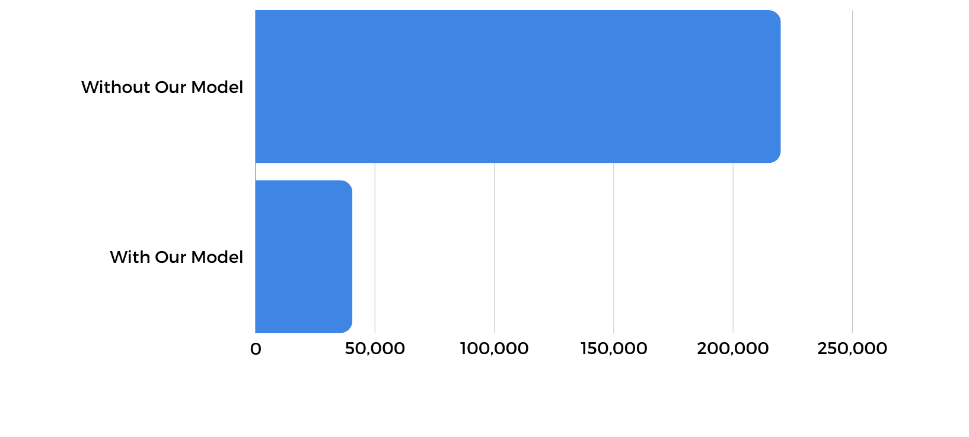


2. Model Suggestion
So, how much can we save?
Significant savings are anticipated, even if we strive to achieve an equivalent lead conversion from last year.
Cost of Identifying Potential Customer
When we target
20%
£220,000
no. of the customer data
We will gain
SAVINGS
£40,590
80%
£179,410
of lead conversion
* Assuming £1 per targeting one customer

Slide 8

3. Marketing Strategies
Who is our potential target customer?
The customer profile derived from World Plus historical data
Occupation:
Self-Employed & Salaried
Age: 40-60
Vintage: 50+
Channel Code: X2 and X4
Have Active
Credit Product
Average Account Balance:
~ 1,200,000

Slide 9
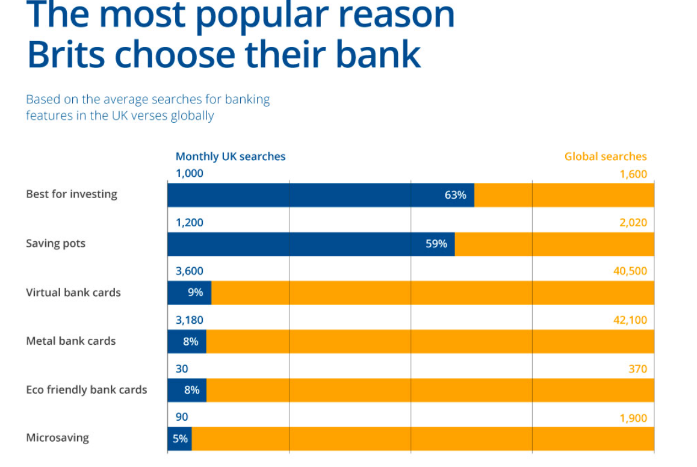
3. Marketing Strategies
How we approach our target
We suggest a marketing strategy based on the market trends and our client’s data
Key Claims
Marketing Methods
The most popular reasons
the Brits choose their banks
Customers’ action
in response to Bank Marketing
Researched a product or service online - 29%
Clicked on a social media ad - 20%
Responded to an email product offer - 18%
Responded to a mail product offer - 16%
Followed a company on social media - 16%
V
V
How do Brits choose their banks?, raisin, 07.04.2022
2024 Marketing Roadmap: More Customer Focus, More Streamlining & Fresh Takes on Life’s Milestones, The Financial Brand, 25,11,23

Slide 10
3. Marketing Strategies
How we approach our target
We suggest a marketing strategy based on the market trends and our client’s data
Acquisition
Retention
Looking for a Saving pot?
Here is the best option
Dear Valued VIP Patron,
We have curated
the optimal deposit for you
Key
Claims
Marketing
Methods
Direct
Mails
Paid-
Social
Search Engine
Optimisation
Direct
Mails
E-mail
SMS/LMS
Demographic & Interest Machine Learning targeting
Strategically use the meta tags with
the key terms that
our main customers find the most
Targeting
Strategy
Send the mails to whom has not converted yet
Regularly send the CRM messages to those who have potential attributes
from our data

Slide 11
Conclusion
Why Us?
Our utmost goal is to ensure the success of our clients' businesses.
THE BEST PARTNER FOR
Customising
ML model for
Precise targeting
Data-Driven
Business
Strategies
Continuous Monitoring &
Maintaining
Recency
World+

Slide 12
Thank you
ANALYTICMINDS

